Slide 1
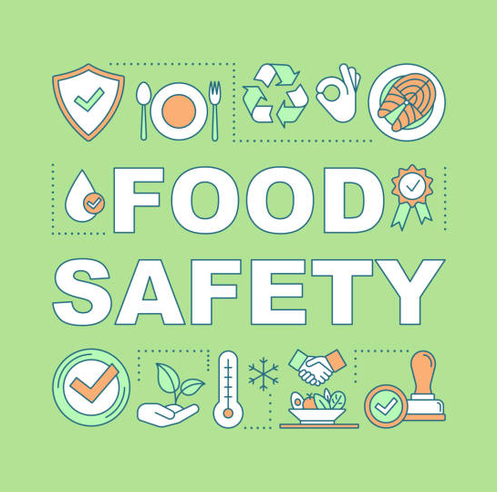
Food Safety for Volunteers

Slide 2
Disclaimer
This presentation is NOT a Safe Food Handling Certification course.
This training is designed to help volunteers know more about Safe Food Handling practices.
Please go to the “Official Food Safety Certification” if you would like the formal training.
Reach out to your agency relations coordinator if you have any questions.

Slide 3
Why is Food Safety Important?
It is important for feeding programs to know basic food safety to ensure neighbors safely receive the food they need.
To ensure the safety and integrity of the food distributed within the Food Bank’s service area:
Food Bank staff and Partner Agencies must be trained in food safety
Food Bank facilities and Partner Agencies are regularly audited and monitored for compliance

Slide 4
Topics Covered in Food Safety
Basic food safety
Personal hygiene
Cross-contamination & allergens
Controlling time and temperature
Controlling wild rodent infestations

Slide 5
Basic Food Safety

Slide 6
How Does Food Become Unsafe?
Unsafe food is usually the result of contamination or hazards, which is the presence of harmful substances in food.
These main 3 include:
Biological – viruses, bacteria, fungi, and parasites.
Chemical – food service chemicals that are used incorrectly.
Physical – band aids, glass, dirt, fish bones.

Slide 7
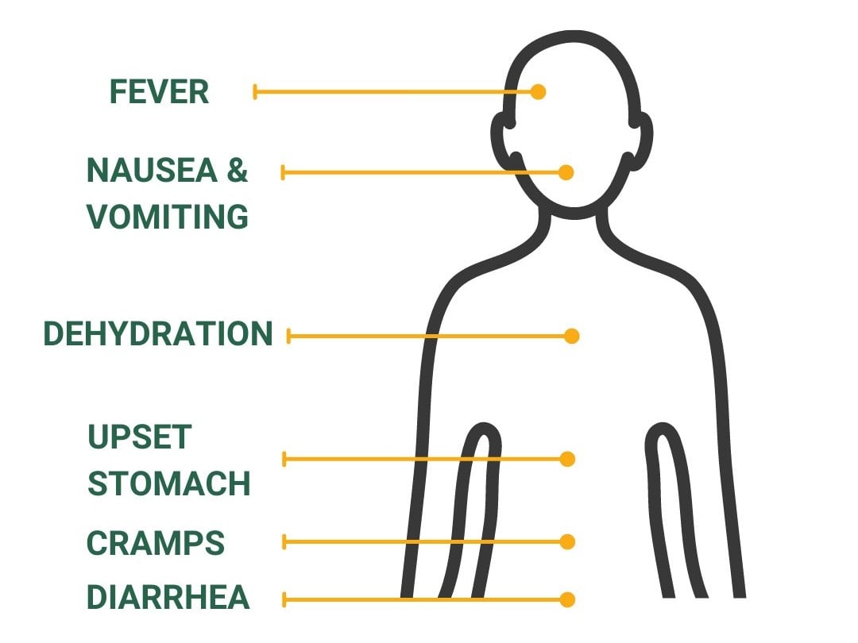
Foodborne Illness
Symptoms can begin in as little as 30 minutes and up to 7 days after ingesting contaminated food.
Children, seniors, pregnant women, and those with chronic illnesses are vulnerable populations who are most at risk.

Slide 8
Personal Hygiene

Slide 9
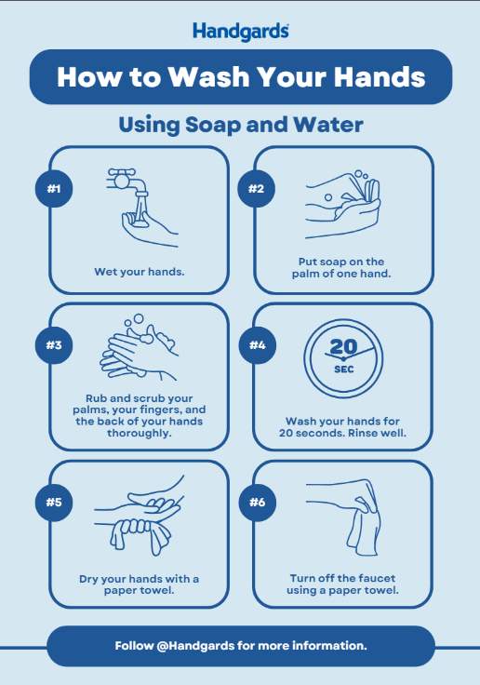
Handwashing
Proper handwashing is critical to preventing the spread of pathogens and avoiding food contamination.
The whole process should take at least 20 seconds, recite the “Happy Birthday to you…” song!
Always washing your hands after:
Using the restroom
Coughing, sneezing, blowing your nose
Eating, drinking, smoking
Taking out the trash
Touching your hair, face, and or body
Before putting on gloves
After touching dirty equipment or surfaces

Slide 10
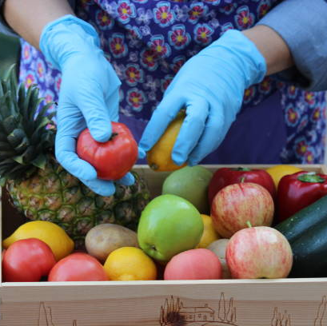
Single Use Gloves
Never rinse, wash, or reuse gloves. Always wash hands before putting on gloves.
Change gloves when:
They are torn.
Before beginning a different task.
After handling raw meat, fish, poultry, or eggs before handling ready to eat foods.
After an interruption, like taking a phone call.
Keep fingernails short and clean.

Slide 11
Controlling Time and Temperature

Slide 12
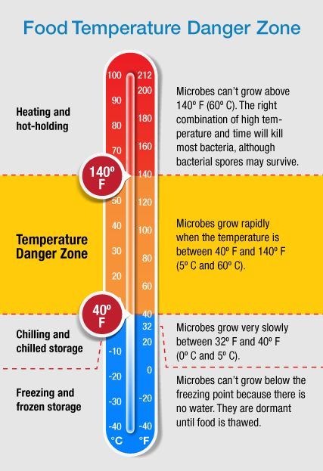
TCS Foods & Temperature
Food that needs time and temperate control for safety is called TCS food.
If held at unsafe temperatures, bacteria will grow over time.
The temperature danger zone is between 41*F – 135*F.
Pathogens on food can grow in this range and cause a foodborne illness.
It is important to keep TCS foods out of this range.
Store cold TSC food in fridges at or below 40*F and frozen TSC food in freezers at or below 0*F.
DO NOT overload coolers or freezers!

Slide 13
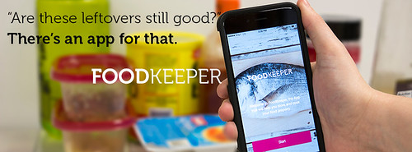
Shelf Life of Food
Best by (or best before): Manufacturers recommended date for best flavor.
Use by: Last date recommended for the use of the product while at peak quality.
Best by and use by are NOT food safety dates.
Sell by: Date that tells the store how long to display the product for sale for inventory management. It is NOT a safety date except for fresh meat, poultry and fish, which must be FROZEN at or before the Sell By Date.
Freeze by: Date that indicates when a product should be frozen to maintain peak quality. It is NOT a sell by or safety date.
Expiration date: Do not use the product beyond this date.
Store items that will expire first in front of those that will expire later. This is referred to as the FIFO method (first in-first out).
Use the food in front first.
Keep all food at least 6 inches off the floor.

Slide 14
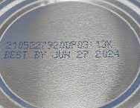
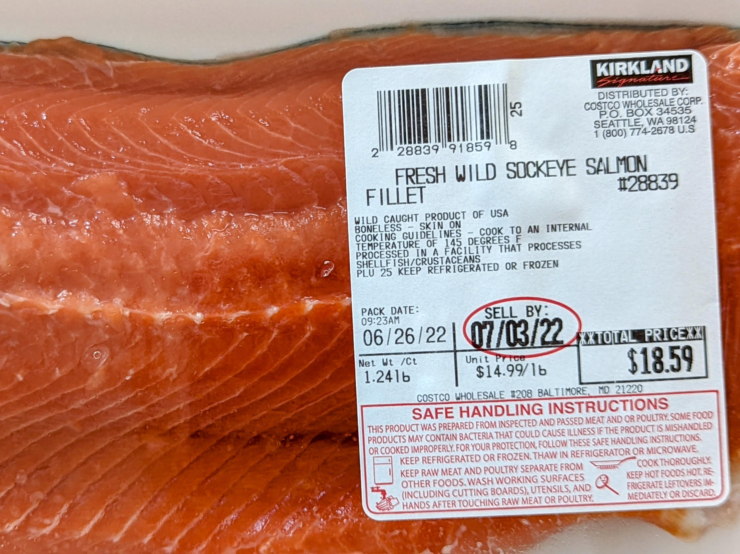
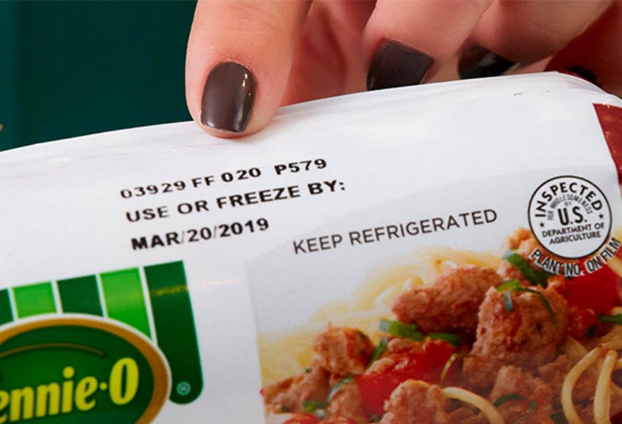
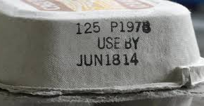
Examples of Labelling Found on Food

Slide 15
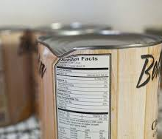
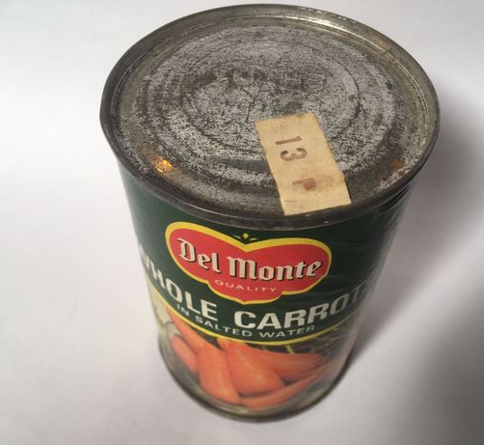
Safe Storage FAQs
Is it safe to use food from dented cans?
Discard deeply dented cans. A deeply dented can is one where you can lay your finger into and often have sharp points. A sharp dent on either the top or side seam can damage the seam and allow bacteria to enter the can.
Is it safe to use rusted canned foods?
You should discard heavily rusted cans. Heavily rusted cans can have tiny holes in them, allowing bacteria to enter. Rust that you can easily remove with a finger or paper towel is safe to keep.

Slide 16
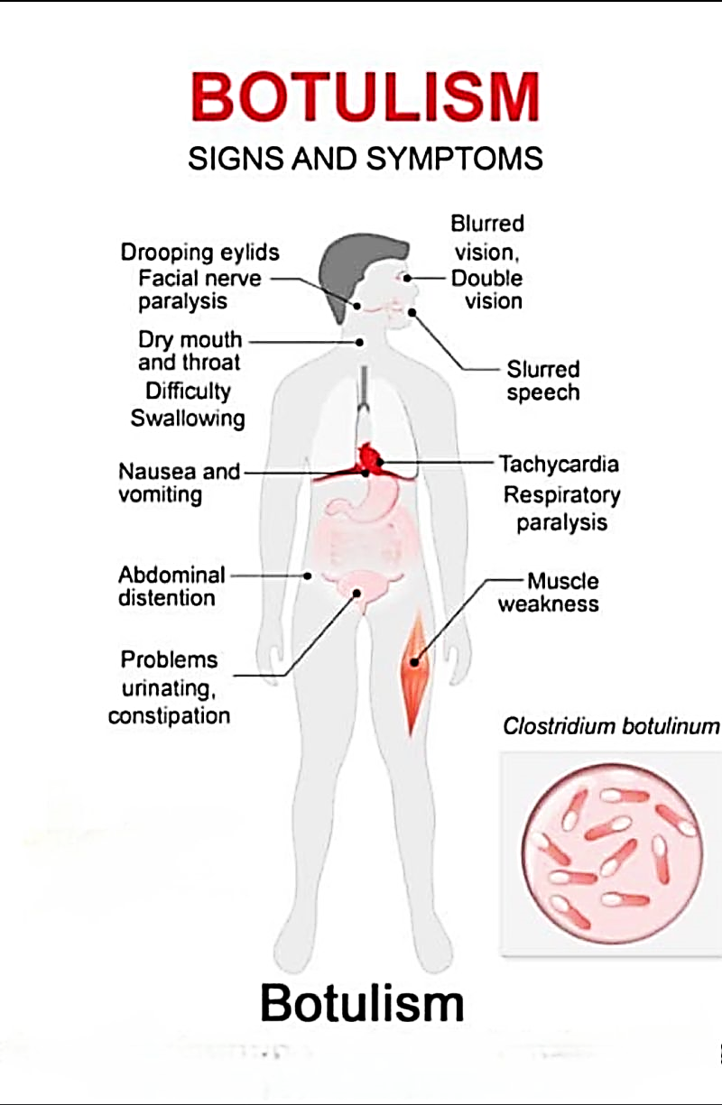
Botulism Dangers
What is the danger of botulism in canned goods?
Botulism is a deadly kind of food poisoning that produces a toxin by the bacteria Clostridium botulinum (C. botulinum).
Symptoms develop in 12 to 48 hours. The poison attacks the nervous system and, without proper treatment, can result in death due to suffocation– the nerves no longer stimulate breathing.
Carefully examine any canned food that looks suspicious. Discard any cans that are leaking, bulging, cracked, badly dented, and or canned food with a foul odor.

Slide 17
Controlling Wild Rodent Infestations

Slide 18
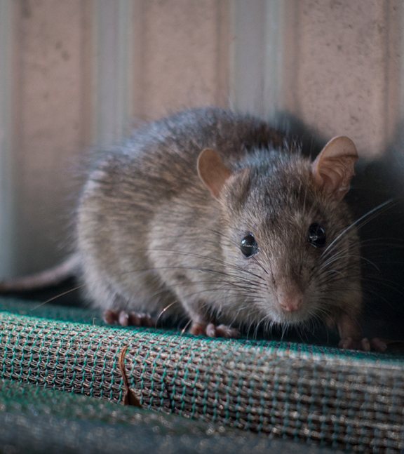
Overview
Diseases coming from rodents, such as rats, mice, and chipmunks, can spread to people directly through:
Contact with rodent droppings
Rodent bites
Handling of rodents
Rodent droppings, urine, and saliva can spread by breathing in air or eating food that is contaminated with rodent waste.

Slide 19
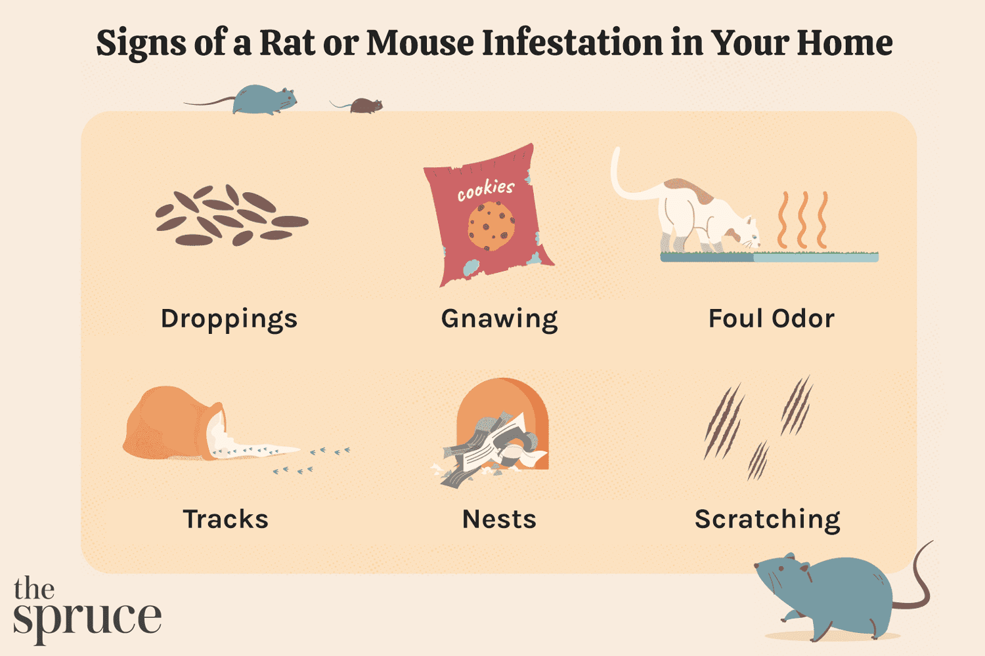
Signs that Rodents are Present
Rodent droppings
Most found in cabinets and drawers. Rodent droppings are pointed at one end and often contain hair.
To know if there are active rodents in the area, safely clean the area. If droppings continue after cleaning, this indicates an active rodent presence.
Gnaw marks
Rats and mice gnaw to create areas in which they can navigate through. Their teeth leave distinct marks and are good indicators that rodents were active in the area. Gnaw marks are often found in the same area as droppings and the same clean-up techniques for rodent droppings can be used to find out if there is an active rodent presence.
It is important to identify signs of rodents before they become established inside of your site.
The two signs of rodent presence are rodent droppings and gnaw marks.

Slide 20
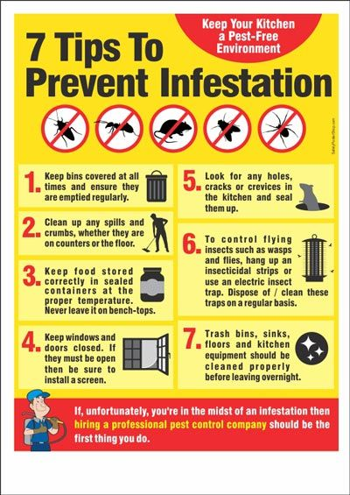
Best Practices for Infestations
Rodents are attracted to food and water sources. To deter rodents, you must:
Keep food sealed in thick plastic, metal, or glass containers with tight lids.
Clean up spilled food right away.
Put pet food away after use and ensure all packaging is secure.
Keep inside garbage in thick plastic or metal containers with tight lids.
Frequently clean the containers with soap and water.
Dispose of trash and garbage on a frequent and regular basis.

